Slide 1
IDP Project Slides for 21.05.24
Dominik Hack
Supervisor: M.Sc. Paula Villa Fulton
Chair of Human Movement Science

Slide 2
Non-ADL Definition
Effects by the environment and not the patient itself influence the IMU Data
ADL should only contain acceleration in one direction for maximum one second (E.g., reaching for an object)
Non-ADL like driving or elevator-rides should result in a continuous acceleration in one direction over a longer period of time

Slide 3
Acceleration of IMU Sensor for 24h
Red areas: Min. 1 second of acceleration in one direction greater than threshold 1.1

Slide 4
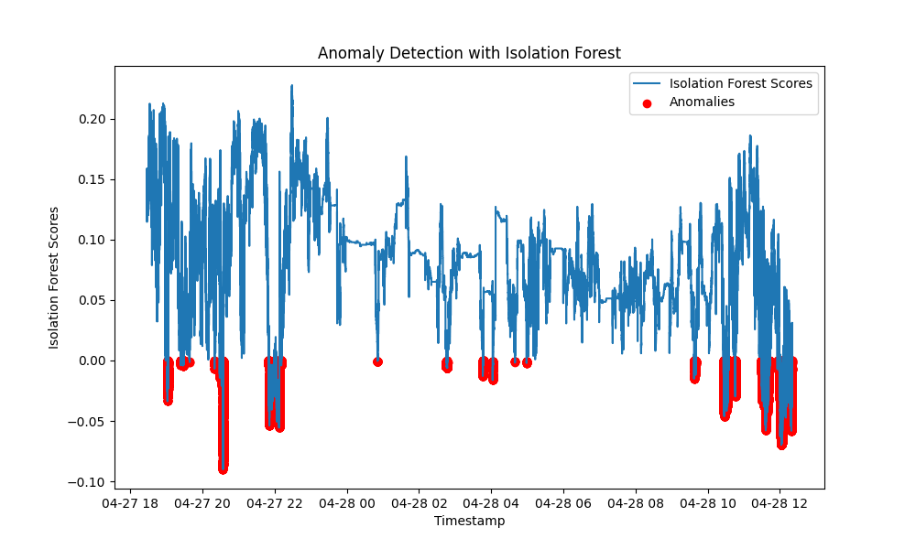
Acceleration and angular-rate data

Slide 5
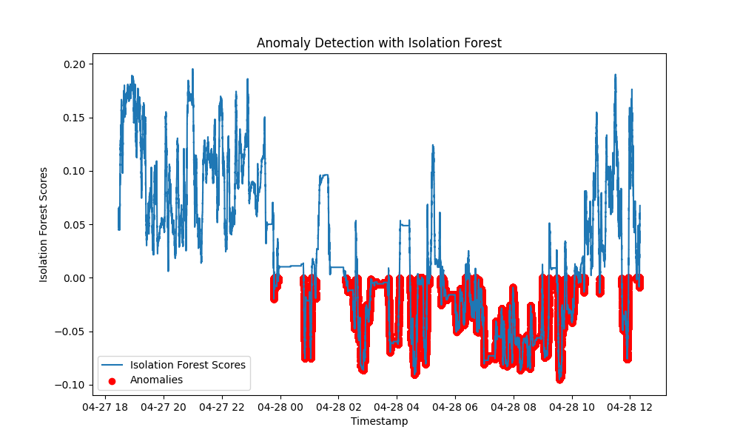
Only acceleration data
Sleep is clearly marked as an anomaly

Slide 6
Only acceleration data and experimenting with custom features to penalize Non-ADL definition

Slide 7
Tweak Isolation Forest Model
Can Angular rate be ignored? Environment normally has no influence on them
Accelerations over one second in one direction need to be panelized
To do:
Hyperparameter analysis
Add sleep to training data

Slide 8
Questions and Problems
How to evaluate the quality of findings
What does the Acceleration-IMU-Data of Non-ADL look like
More complex models are expensive

Slide 9
Experiments with Darts

Slide 10
Detailed schedule
21.5 – 3.6:
Tweak models to get more concrete results
Try out more supervised models
More literature research
3.6 - ???:
Add additional topic to the research question
Analyze the results
Start with the thesis writing

